Slide 1

Netflix User Base Dataset Analysis

Slide 2
Business Problem
The dataset provides a detailed overview of a sample Netflix user base, highlighting customer demographics, spending behaviors, and payment preferences. Each record corresponds to a unique user, identified by their User ID, and includes essential information such as subscription type (Basic, Standard, or Premium), monthly revenue, join date, last payment date, and country of residence.

Slide 3
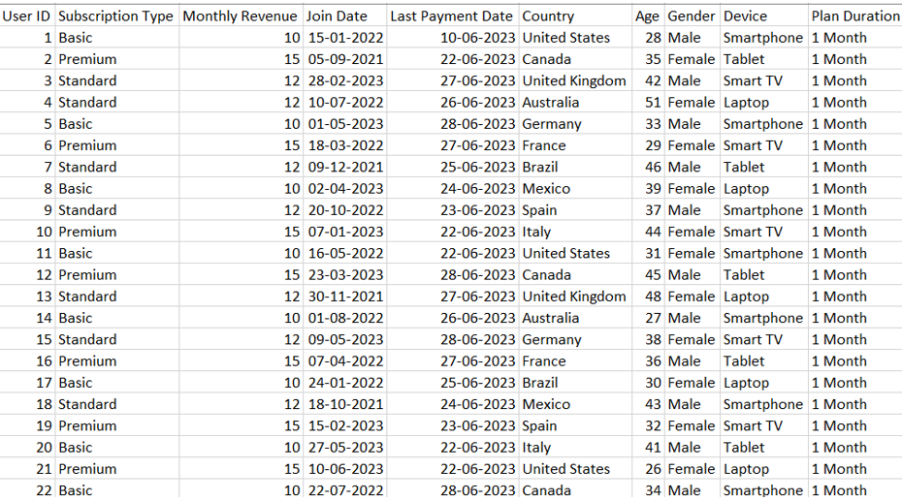
Data Dump

Slide 4
Dataset Overview
Total Records: 2,500 rows representing 3 years (2021 – 2023).
Categorical Features (10): Covers variables such as Subscription Types,Devices, and Customer gender.
Source – Kaggle (link)

Slide 5
Analysis Steps
After obtaining the raw data from Kaggle, the following steps were taken for analysis:
•Conditional Formatting: Applied 2 rules to highlight important data points.
•Pivot Tables: Created multiple pivots and charts for data visualization.
•Sparklines: Used sparklines to analyze trends across features.
A total of 4 charts were generated to provide a clear, visual representation of the analysis.

Slide 6
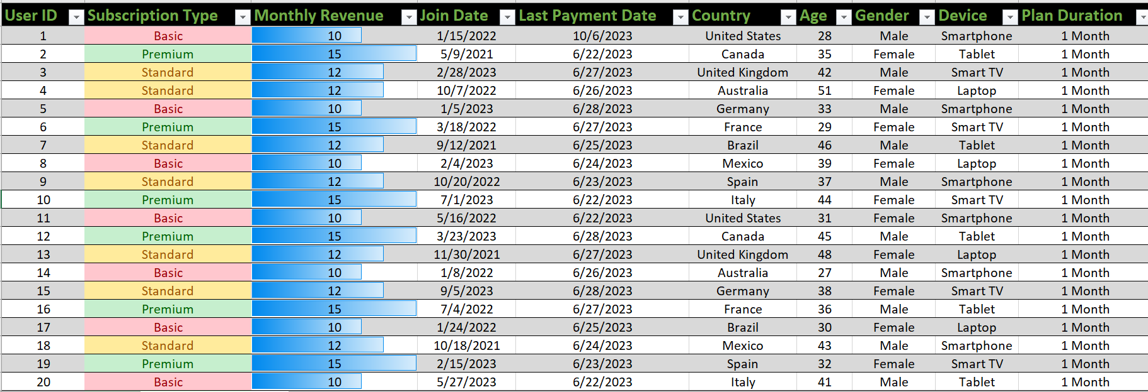
Conditional Formatting
Conditional formatting rules were applied to facilitate quick data analysis:
Subscription Plans:
Apply conditional formatting to highlight different subscription tiers (e.g., "Basic", "Standard", "Premium") with distinct colors. This makes it easier to visually distinguish between the various subscription plans.
Monthly Revenue: Conditional formatting can be used to apply a gradient color scale based on revenue. This allows you to quickly identify high and low revenue values.

Slide 7

sparklines
Sparklines are a visual representation of data that allows you to quickly see the trend of data points without needing to analyze a complex table or chart. They can be used in various applications such as dashboards, spreadsheets, presentations, and reports.

Slide 8
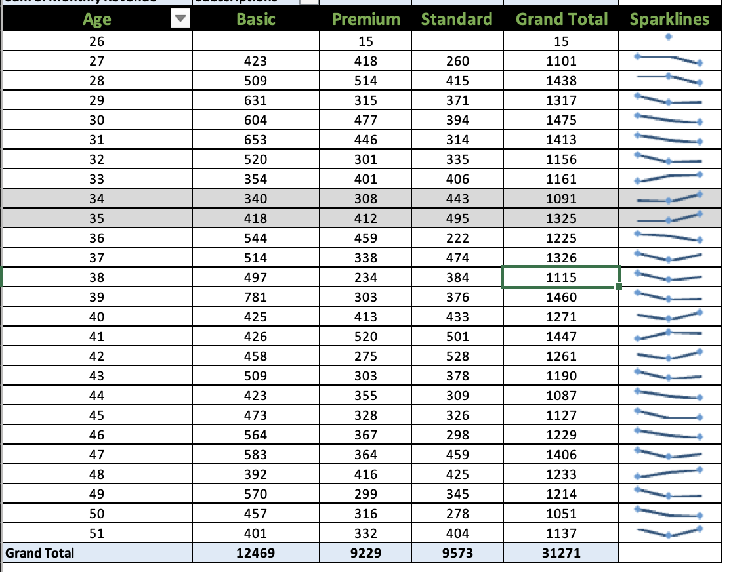
NETFLIX Subscriptions
Here's what we can infer from the sparklines about the Netflix Subscription According to the age groups difference. * Younger Age Groups (26-35): These groups generally show a more consistent upward trend, suggesting a steady increase in subscriptions over time. * Middle Age Groups (36-45): Some groups within this range exhibit more fluctuations, possibly indicating periods of greater or lesser interest in Netflix. * Older Age Groups (46-51): These groups may be more consistent in their subscriptions, suggesting a stable user base.

Slide 9
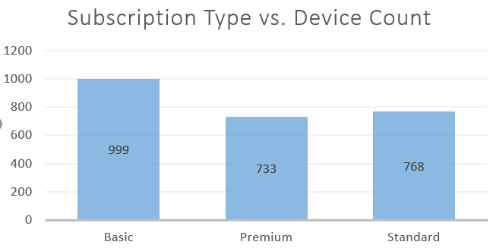
Subscription Type vs. Device Count
The majority of subscriptions are for basic plans, with 999 devices subscribed, followed by the standard plan at 768 devices and the premium plan at 733 devices. This indicates a clear preference for the basic plan over the other options.

Slide 10
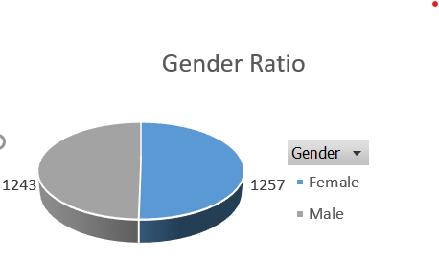
Customer Demographics
This chart shows that the majority of Netflix users are female, comprising 50.28%, while males account for the remaining 49.72%.

Slide 11
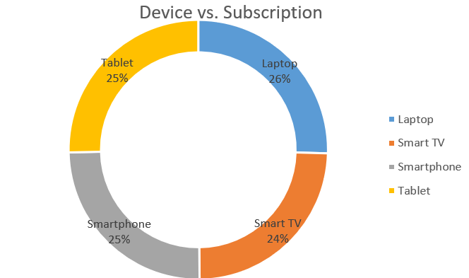
Device vs. Subscription Count
A chart has been created to show the subscription counts for different devices: smart TVs have 610 subscriptions, smartphones have 621, tablets have 633, and laptops lead with the highest count at 636 subscriptions.

Slide 12
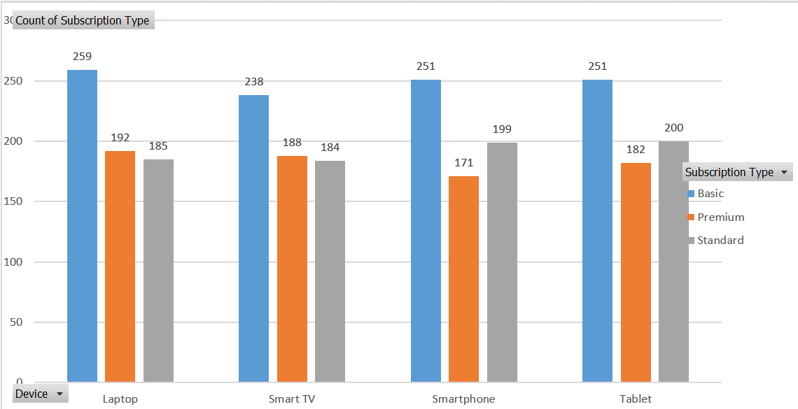
Subscription Counts Across Various Devices
The majority of Devices, statistically preferably use basic subscription plans.
Premium users prefer laptops and TVs compared to smartphones and tablets, as enhanced features are more accessible on them.
Regarding standard users, we see that users prefer to use smartphones and tablets much more than laptops and TVs.

Slide 13



